Slide 1
Introduction to Survival Analysis

Slide 2
How Webinar Will Work:
45 minutes of teaching
Questions answered at the very end
Recording will be sent via email within 48 hours

Slide 3

?
✓
1.
✓
2.
✓
3.
4.
Problem:
Today’s Solution:
Additional Resources:
1. Need to understand Survival Analysis’ unique data, concepts, issues
2. Many methods based on these for different situations
1. Clear understanding of some fundamental data issues,
vocabulary, graphs, and tests 2. Example of an extension: Competing Risks Model
Survival Analysis Workshop

Slide 4
Special offer at the end:
Survival Analysis: Models for Time to Event Data
Dates: September 11th – November 19th, 2018
Investment: $797
Software: R, SAS, SPSS, Stata
Level: Intermediate
http://bit.ly/survival-analysis-workshop-discount

Slide 5

About Instructor Steve Simon, PhD
Faculty in the Department of Biomedical and Health Informatics at the University of Missouri-Kansas City
Over 90 peer-reviewed publications; four major awards
Received PhD in Statistics from the University of Iowa
Current areas of interest:
Bayesian models to forecast patient accrual in clinical trials

Slide 6
What You Will Learn:
See and learn how to interpret a variety of Kaplan-Meier curves, the fundamental graphical display for survival data
The underlying calculations of a Kaplan-Meier curve
An advanced application of competing risks analysis using a Political Science example of duration of leadership in the world’s countries

Slide 7
Fruit fly data (round 1)
Where does this data come from?
The following data represents survival time for a group of fruit flies and is a subset of a larger data set found at the Data and Story Library (DASL). The data set has been slightly modified to simplify some of these explanations.
There are 25 flies in the sample, with the first fly dying on day 37 and the last fly dying on day 96. If you wanted to estimate the survival probability for this data, you would draw a curve that decreases by 4% (1/25) every time a fly dies.

Slide 8
Fruit fly data (round 1)
At each date, the survival probability drops by 1/25.
37 96% 40 92% 43 88% 44 84% 45 80% 47 76% 49 72%
54 68% 56 64% 58 60% 59 56% 60 52% 61 48% 62 44%
68 40%
70 36% 71 32% 72 28% 73 24% 75 20% 77 16%
79 12% 89 8% 94 4% 96 0%.

Slide 9
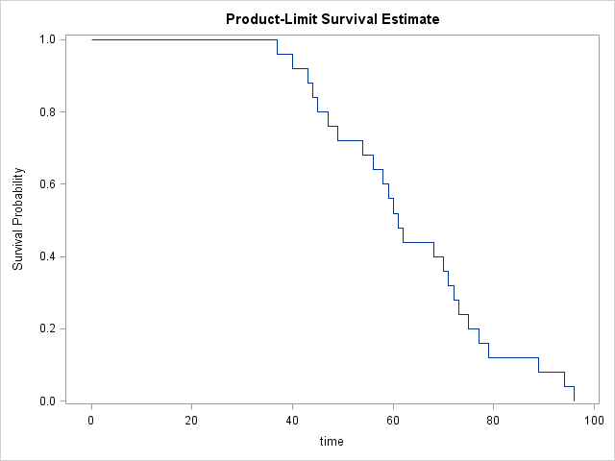
Fruit fly data (round 1)
A graphical depiction of the survival probability

Slide 10
Fruit fly data (round 2)
Let’s alter the experiment
Suppose that totally by accident, a technician leaves the screen cover open on day 70 and all the flies escape. You're probably worried that the whole experiment has been ruined. But don't be so pessimistic. You still have complete information on survival of the fruit flies up to their 70th day of life. Here's how you would present the data and estimate the survival probabilities.

Slide 11
Fruit fly data (round 2)
You can still estimate some survival probabilities
37 96% 40 92% 43 88% 44 84% 45 80% 47 76% 49 72%
54 68%
56 64% 58 60% 59 56% 60 52% 61 48% 62 44%
68 40% 70+ ? 70+ ? 70+ ? 70+ ? 70+ ? 70+ ?
70+ ? 70+ ? 70+ ? 70+ ?

Slide 12
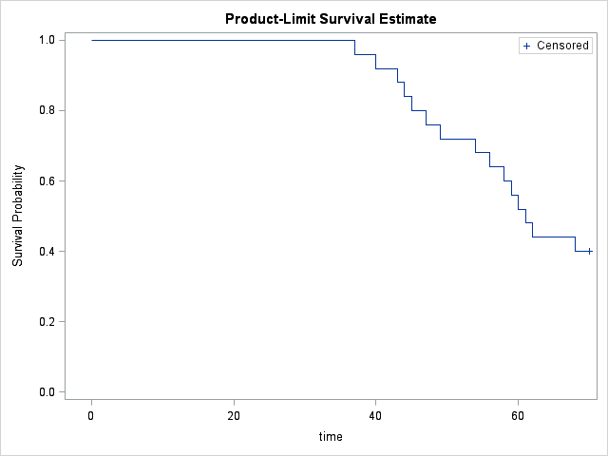
Fruit fly data (round 2)
Here is a graph of the survival probabilities

Slide 13
Fruit fly data (round 2)
What you can still estimate
We clearly have enough data to make several important statements about survival probability. For example, the median survival time is 61 days because roughly half of the flies had died before this day.
By the way, you might be tempted to ignore the ten flies who escaped. But that would seriously bias your results. The median survival time, for example, of the 15 flies who did not escape, for example, is only 54 days which is much smaller than the actual median.

Slide 14
Fruit fly data (round 3)
Another change to the data
Let's look at a third experiment, where the screen cover is left open and all but four of the remaining flies escape. It turns out that those four remaining flies who didn't bug out will allow us to still get reasonable estimates of survival probabilities beyond 70 days. Here is the data and the survival probabilities.

Slide 15
Fruit fly data (round 3)
Here are the estimated survival probabilities
37 96% 40 92% 43 88% 44 84% 45 80% 47 76% 49 72%
54 68%
56 64% 58 60% 59 56% 60 52% 61 48% 62 44%
68 40% 70+ ? 71 30% 70+ ? 70+ ? 75 20% 70+ ?
70+ ? 89 10% 70+ ? 96 0%

Slide 16
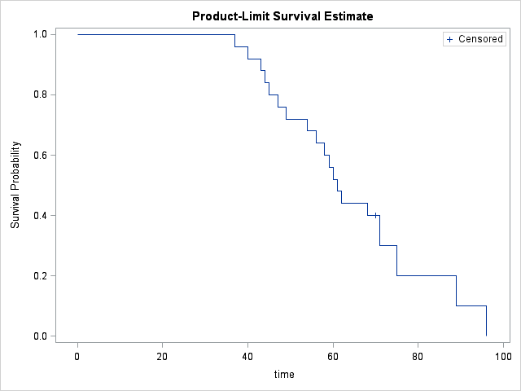
Fruit fly data (round 2)
Here is a graph of the survival probabilities

Slide 17
An Introduction to Kaplan-Meier Curves
Fruit fly data (round 3)
What you do with the six escaped flies is to allocate their survival probabilities equally among the four flies who didn't bug out. This places a great responsibility among each of those four remaining flies since each one is now responsible for 10% of the remaining survival probability, their original 4% plus 6% more which represents a fourth of the 24% survival probability that was lost with the six escaping flies.

Slide 18
Fruit fly data (round 3)
Informative censoring
If the censoring mechanism were somehow related to survival prognosis, then you would have the possibility of serious bias in your estimates. Suppose for example, that only the toughest of flies (those with the most days left in their short lives) would have been able to escape. The flies destined to kick the bucket on days 70, 71, 72, and 73, were already on their deathbeds and unable to fly at all, much less make a difficult escape. Then these censored values would not be randomly interspersed among the remaining survival times, but would constitute some of the larger values. But since these larger values would remain unobserved, you would underestimate survival probabilities beyond the 70th day.

Slide 19
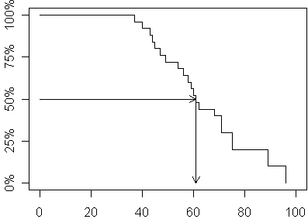
Fruit fly data (round 3)
Interpretation: 50th percentile = 61

Slide 20
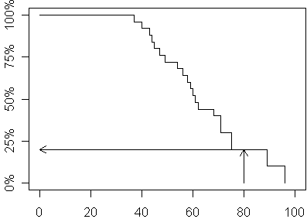
Fruit fly data (round 3)
Interpretation: 80 week survival probability = 20%

Slide 21


Slide 22
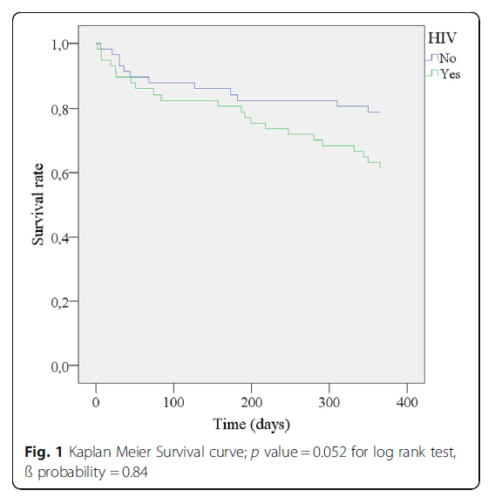

Slide 23
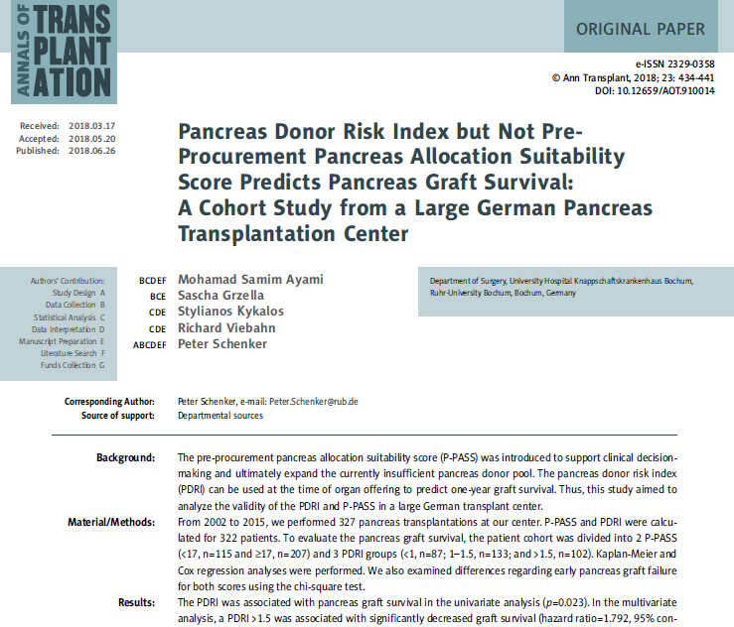

Slide 24
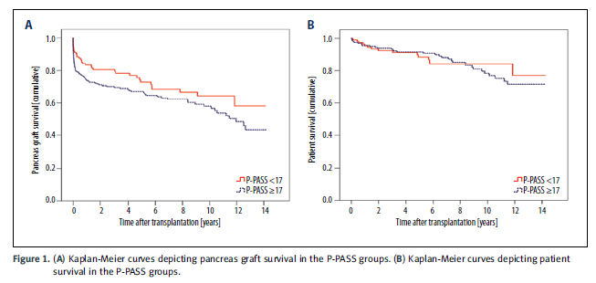

Slide 25


Slide 26
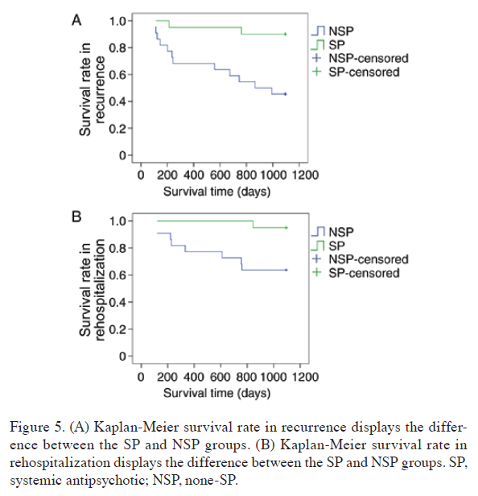

Slide 27


Slide 28
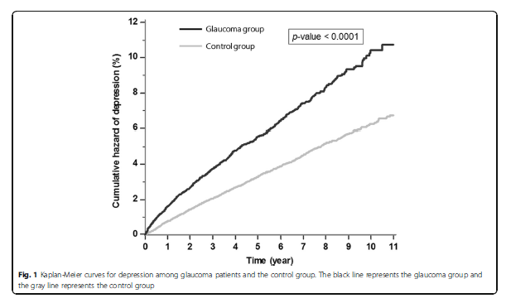

Slide 29


Slide 30
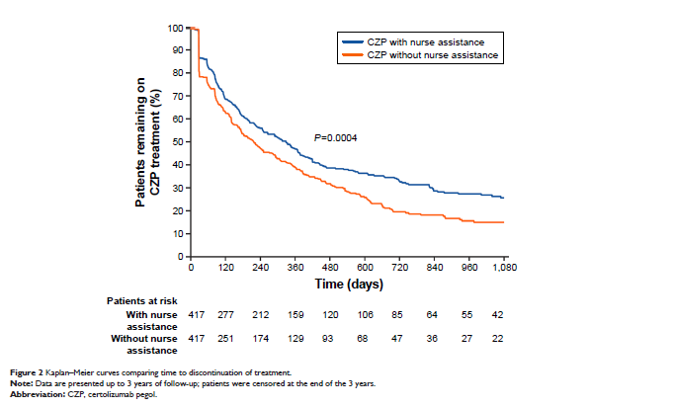

Slide 31


Slide 32
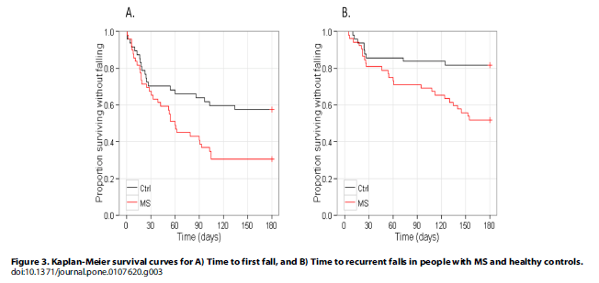

Slide 33
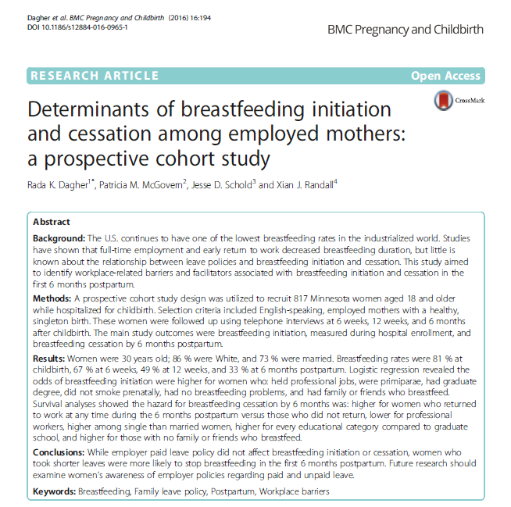

Slide 34
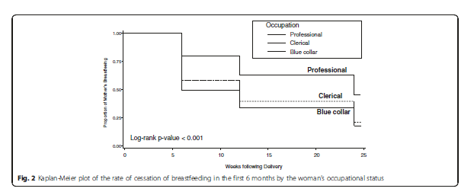

Slide 35


Slide 36
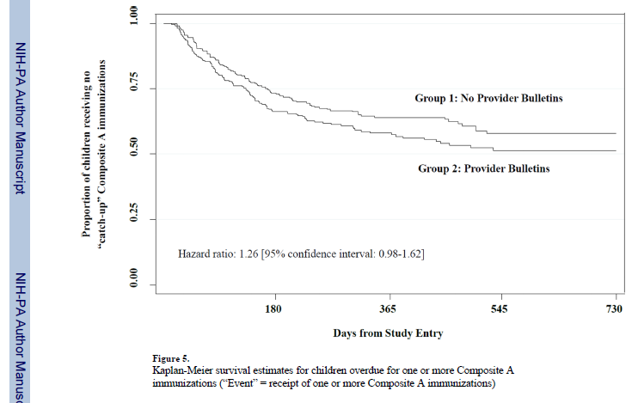

Slide 37
The leader data set
Overview
This data set tracks leaders of countries of the world and how long they stay in power. Leaders can be removed by constitutional means, by natural death, or by nonconstitutional means (military coup or assassination, for example). This data set is restricted to 1960 through 1987, and does not include North America.

Slide 38
The leader data set
Variables
years Min. 1st Qu. Median Mean 3rd Qu. Max.
0.000 1.000 3.000 5.114 7.000 27.000
lost still in power constitutional exit
111 146
natural death nonconstitutional exit
27 154

Slide 39
The leader data set
Variables
manner constitutional ascent
280
nonconstitutional ascent
158
start Min. 1st Qu. Median Mean 3rd Qu. Max.
1960 1965 1973 1973 1979 1987
military no yes
294 144

Slide 40
The leader data set
Variables
conflict low conflict medium/high conflict
166 272
age Min. 1st Qu. Median Mean 3rd Qu. Max.
17.00 41.00 50.00 49.39 56.75 81.00
loginc Min. 1st Qu. Median Mean 3rd Qu. Max.
4.094 5.075 5.858 5.916 6.565 9.546

Slide 41
The leader data set
Variables
growth Min. 1st Qu. Median Mean 3rd Qu. Max.
-7.00 0.50 1.50 1.63 3.40 8.50
Pop Min. 1st Qu. Median Mean 3rd Qu. Max.
0.008 2.600 7.000 35.78 24.00 1088.00
Land Min. 1st Qu. Median Mean 3rd Qu. Max.
0.02 49.00 238.0 740.0 912.0 9596.00

Slide 42
The leader data set
Variables
literacy Min. 1st Qu. Median Mean 3rd Qu. Max.
5 32 65 59.41 85 99
region middle east africa
60 132
asia latin america
91 155

Slide 43
The leader data set
Check for sufficient number of events in each group
manner 0 1
constitutional ascent 70 210
nonconstitutional ascent 41 117
military 0 1
no 70 224
yes 41 103

Slide 44
The leader data set
Check for sufficient number of events in each group
conflict 0 1
low conflict 42 124
medium/high conflict 69 203
region 0 1
middle east 18 42
africa 42 90
asia 26 65
latin america 25 130

Slide 45
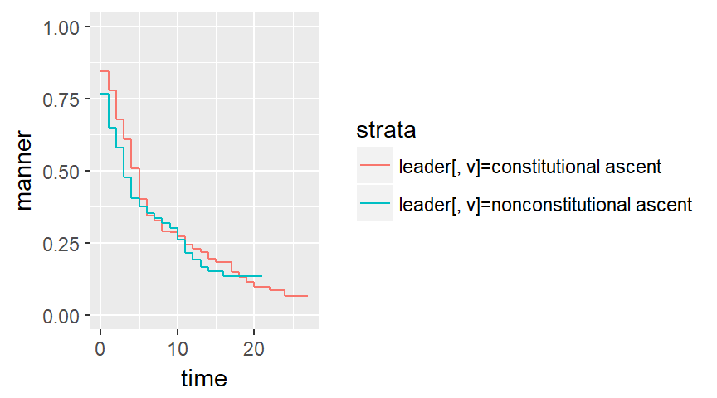
The leader data set, Kaplan-Meier curves

Slide 46
The leader data set
Run a multivariate Cox model
coef exp(coef) se(coef) z p-v
manner 0.359963 1.433277 0.153237 2.349 0.0188
military -0.128457 0.879451 0.157289 -0.817 0.4141
age 0.024148 1.024442 0.004967 4.862 0.0001

Slide 47
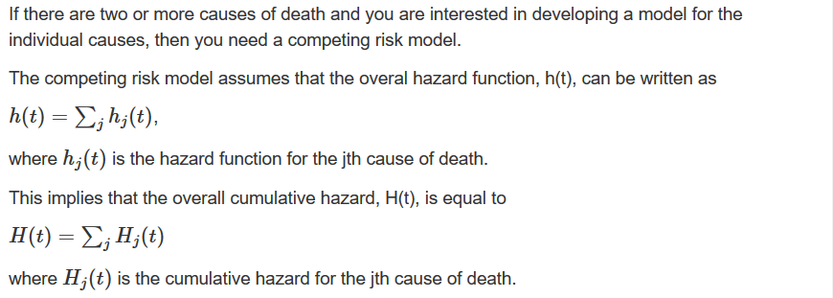
The competing risks model
If there are two or more causes of death and you are interested in developing a model for the individual causes, then you need a competing risk model.
The competing risk model assumes that the overal hazard function, h(t), can be written as
where h_{j}(t) is the hazard function for the jth cause of death.
This implies that the overall cumulative hazard, H(t) is equal to
Where H_{j}(t) is the cumulative hazard for the jth cause of death.

Slide 48
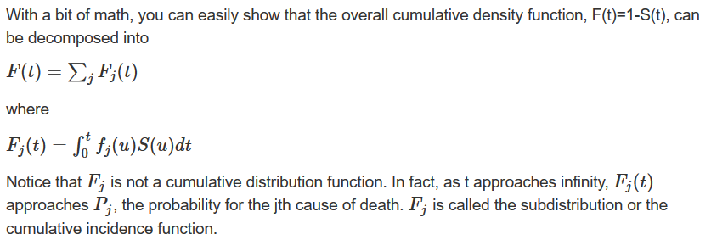
The competing risks model
With a bit of math, you can easily show that the overall cumulative density function, F(t)=1-S(t), can be composed into
Where
Notice that F_{j} is not a cumulative distribution function. In fact, as t approaches infinity, F_{j}(t) approaches P_{j}, the probability of the jth cause of death. F_{j} is called the subdistribution or the cumulative incidence function.

Slide 49
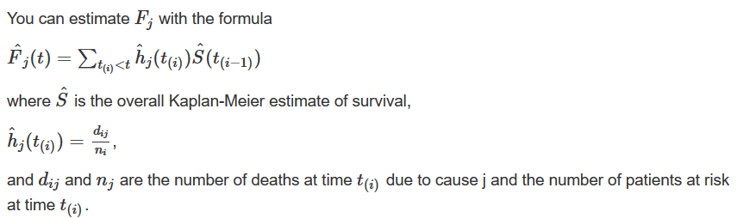
The competing risks model
You can estimate F_{j} with the formula
where is the overall Kaplan-Meier estimate of the survival,
and d_{ij} and n_{j} are the number of deaths at time t_{(i)} due to cause j and the number of patients at risk at time t_{(i) .}

Slide 50
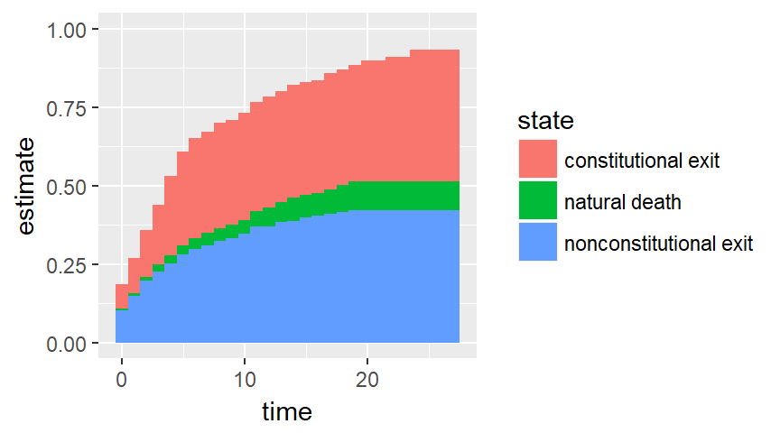
The leader data set, competing risks

Slide 51
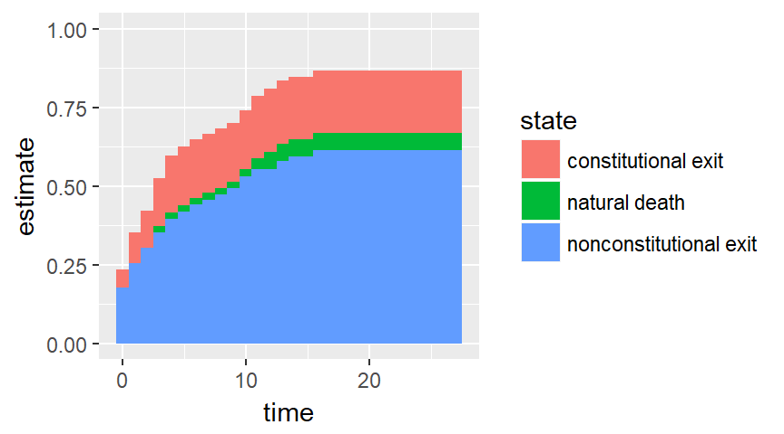
Subgroup nonconstitutional ascent

Slide 52
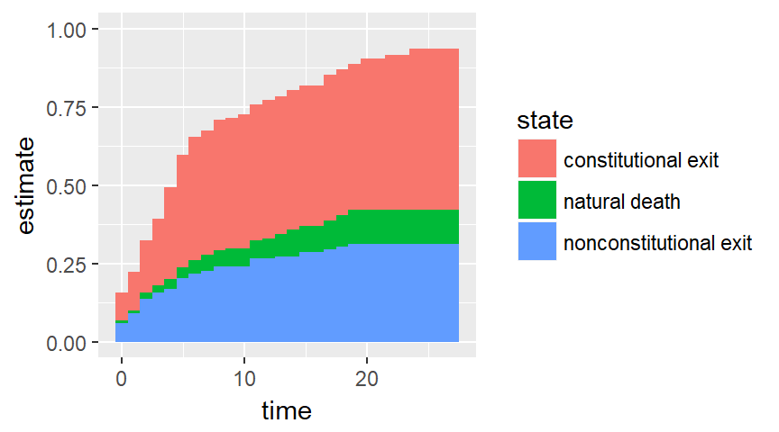
Subgroup constitutional ascent

Slide 53
Conclusion
What have you learned today?
Simple example of censoring
Applications of survival analysis beyond survival
Interpretation of the Kaplan-Meier curve
Simple example of competing risk analysis

Slide 54
Workshop Details
Survival Analysis: Models for Time to Event Data
Dates: September 11th – November 19th, 2018
Modules: 8
Investment: $797 $637
Software: R, SAS, SPSS, Stata
Level: Intermediate
Special Bonus:
20% Off
until July 31st
http://bit.ly/survival-analysis-workshop-discount

